Slide 1

Notes:
Image Source: Damon Hall
https://unsplash.com/photos/Bm4fA1CH4Hg

Slide 2
Modelling the Economic Growth of the Philippines using Support Vector Machine and ARIMA Time Series Forecasting
Systems analysis & Quantitative Methods
Presented by:
Mark Anthony A. Cabanlit
Notes:
Image Source: Damon Hall
https://unsplash.com/photos/Bm4fA1CH4Hg
1. Introduction 2. Method 3. Results and Discussion 4. Conclusions

Slide 3
Contents
Introduction
2. Methods
3. Results and Discussion
4. Conclusion
Notes:
Image Source: Damon Hall
https://unsplash.com/photos/Bm4fA1CH4Hg

Slide 4

Introduction
Objectives, Dataset, Data Source, Data Structures
Notes:
Economic indicators portray the “big-picture” of a country or region in regards to the economy. A single indicator or a small set of indicators attempts to give you an idea of the overall economic health of a particular geography. It can help investors assess whether financial markets are in line with economic fundamentals or if there’s a mismatch. This indicates either a run-up in financial markets ahead of fundamentals or markets that are lagging behind. This information can be useful for investors when they’re making investment and asset allocation decisions.
Whether it’s for ongoing monitoring or studying the fundamentals of an economy for the first time, the indicators will give investors a flavor of how a particular economy is faring.

Slide 5
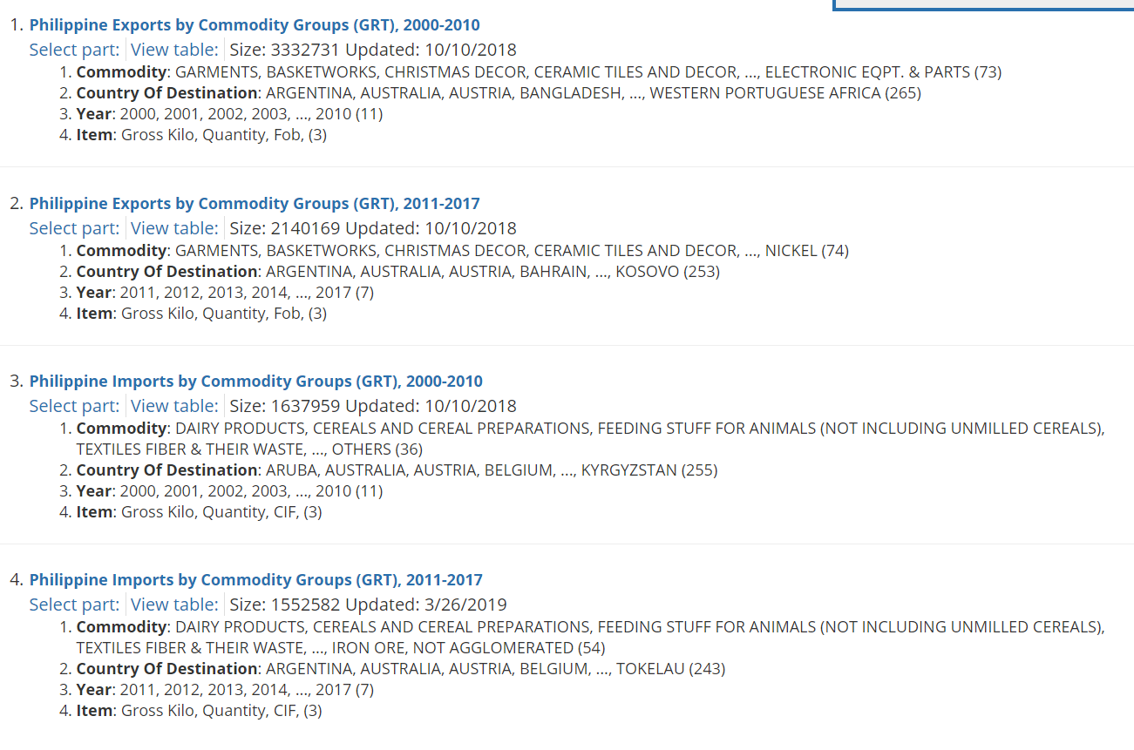
Dataset
Dataset
The dataset was taken from:
Trade: International Merchandise and Domestic
of the OpenStat website of the Philippine Statistics Authority.

Slide 6
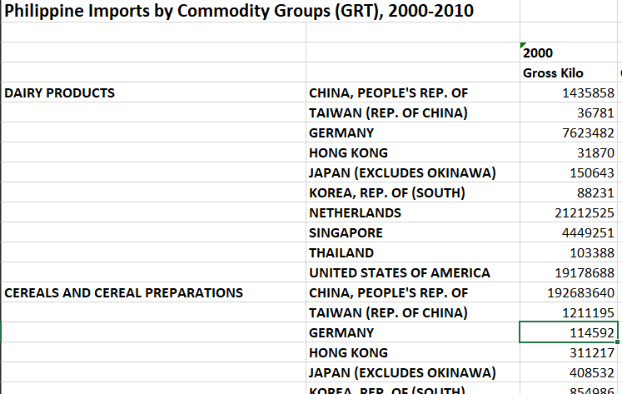
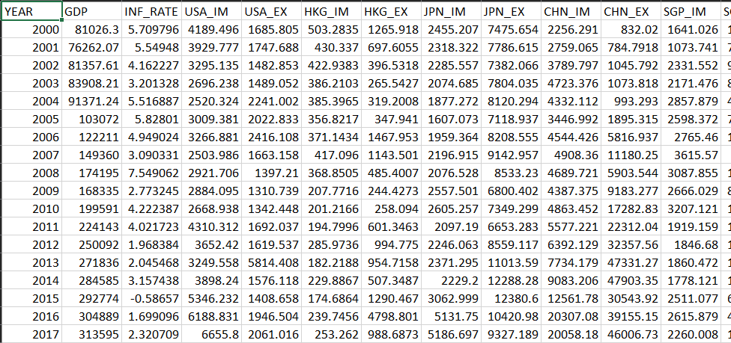
Data
Downloaded Data
Pre-processed data

Slide 7

GDP
The most watched data for any economy—economic growth. Economic growth can be considered among the most crucial indicators that are released. The reason why it’s so important is that it indicates the growth in economic output, whether measured by GDP (gross domestic product), GVA (gross value added), or any other measure. Assessing economic output also helps investors understand what drives an economy. (Ashworth, 2015)
Data: https://data.worldbank.org/indicator/NY.GDP.MKTP.CD?end=2017&locations=PH&start=2000

Slide 8

Inflation
Inflation represents a rise in the general price level in a country or region. The higher the inflation, the lower the quantum of a particular good that can be purchased compared to the past.
Like economic growth, inflation is comparable for countries in the same stage of evolution in the business cycle. Emerging economies have a higher rate of consumption growth and spending growth. As a result, a high level of inflation is normal for these economies.
Notes:
https://unsplash.com/photos/SgraLCyISWs
In contrast, nations with mature economies already have developed infrastructure and facilities. They don’t need large investments in those cost-intensive areas. As a result, they generally don’t experience a high level of inflation. Also, higher inflation for developed countries has implications like reduced international competitiveness of goods produced. Their costs of production will be pushed higher. (Ashworth, 2015)

Slide 9

Imports and Exports
Imports and exports—the staples of international trade—may seem like terms that have little bearing on everyday life for the average person, but they can, in fact, exert a profound influence on both the consumer and the economy.
A healthy economy is one where both exports and imports are growing. This typically indicates economic strength and a sustainable trade surplus or deficit. (Kramer, 2019)

Slide 10










Philippines Top Trading Partners
Notes:
United States
Hong Kong
Japan
China
Singapore
Germany
Thailand
South Korea
Netherlands
Taiwan

Slide 11

Methods
Workflow, Support Vector Machine, ARIMA Time Series Forecasting

Slide 12
Workflow
GDP
INF_RATE
Dataset Creation
USA_(IM/EX)
Inflation Rate
HKG_(IM/EX)
Linear Regression
JPN_(IM/EX)
CHN_(IM/EX)
Neural Network
Collation
SGP_(IM/EX)
GER_(IM/EX)
Support Vector Machine
THA_(IM/EX)
Export Dataset
Import Dataset
KOR_(IM/EX)
Recursive Partitioning
NLD_(IM/EX)
TWN_(IM/EX)
GDP
Notes:
USA_IM USA_EX HKG_IM HKG_EX JPN_IM JPN_EX CHN_IM CHN_EX SGP_IM SGP_EX GER_IM GER_EX THA_IM THA_EX KOR_IM KOR_EX NLD_IM NLD_EX TWN_IM TWN_EX

Slide 13
Workflow (cont’d)
INF_RATE
INF_RATE_F
USA_(IM/EX)
USA_(IM/EX)_F
HKG_(IM/EX)
HKG_(IM/EX)_F
JPN_(IM/EX)
Time Series
JPN_(IM/EX)_F
CHN_(IM/EX)
Forecast
CHN_(IM/EX)_F
SGP_(IM/EX)
ARIMA (p, d, q)
SGP_(IM/EX)_F
GER_(IM/EX)
GER_(IM/EX)_F
THA_(IM/EX)
THA_(IM/EX)_F
Prediction
KOR_(IM/EX)
KOR_(IM/EX)_F
NLD_(IM/EX)
NLD_(IM/EX)_F
TWN_(IM/EX)
TWN_(IM/EX)_F

Slide 14
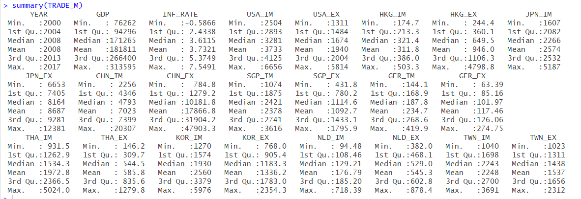
Summary

Slide 15
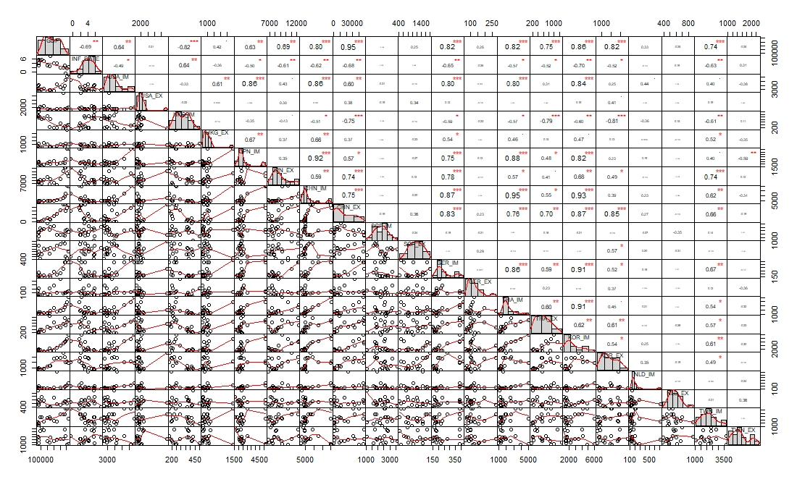
Correlation

Slide 16
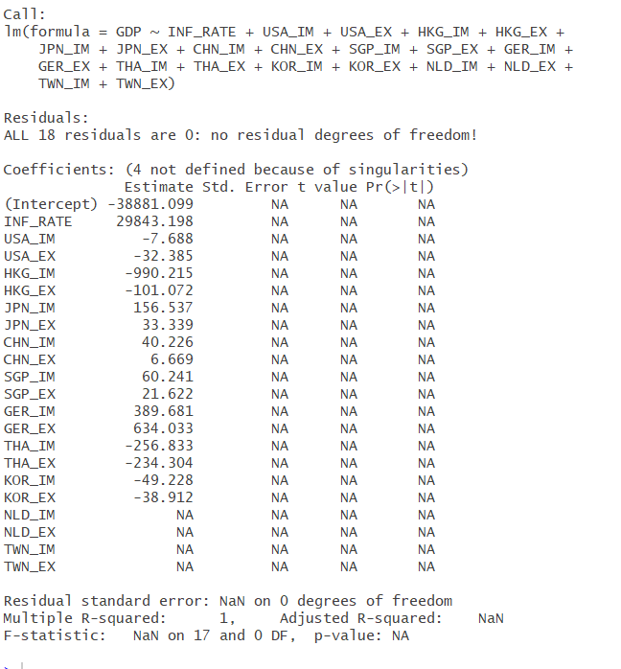
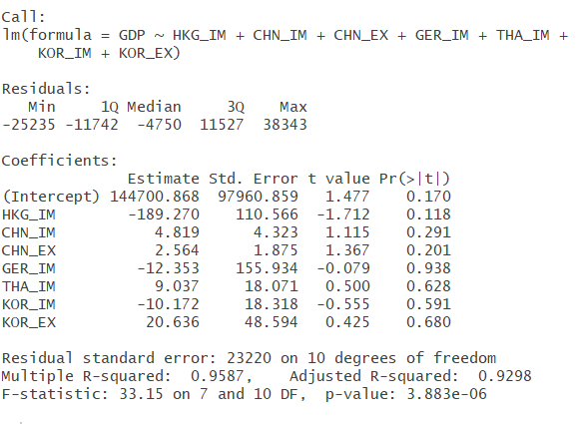
Multiple Linear Regression

Slide 17
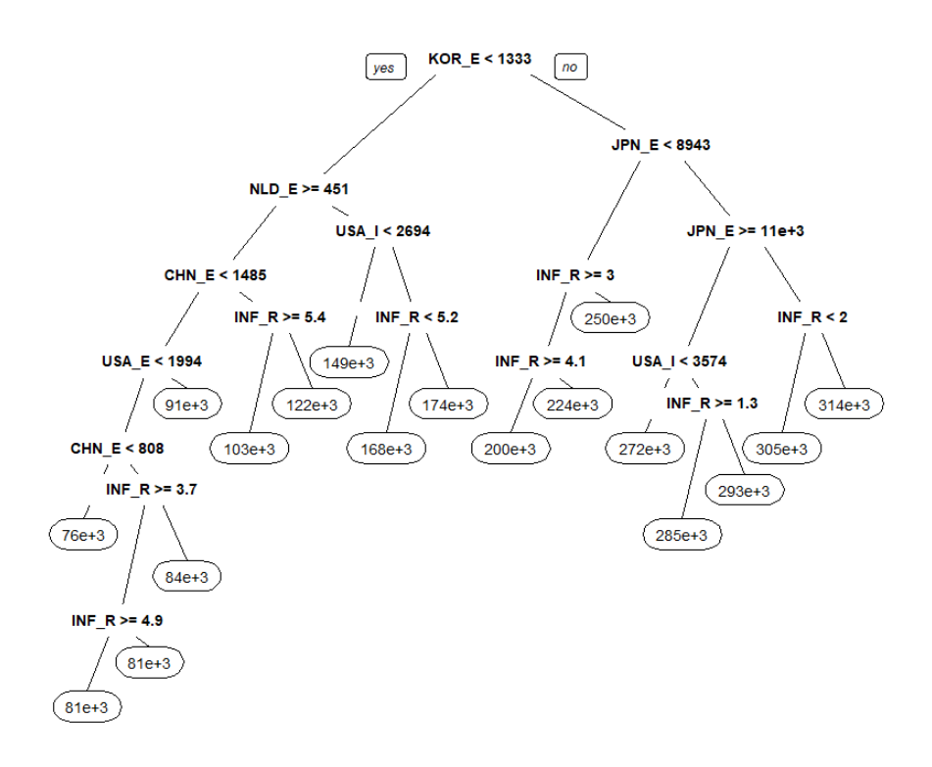
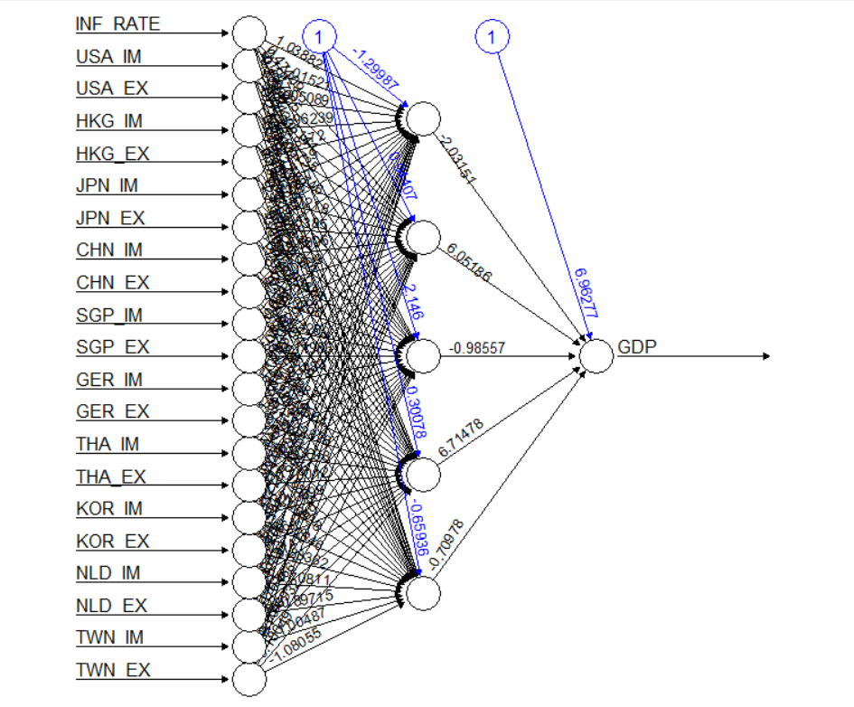
Recursive Partitioning
Neural Network

Slide 18
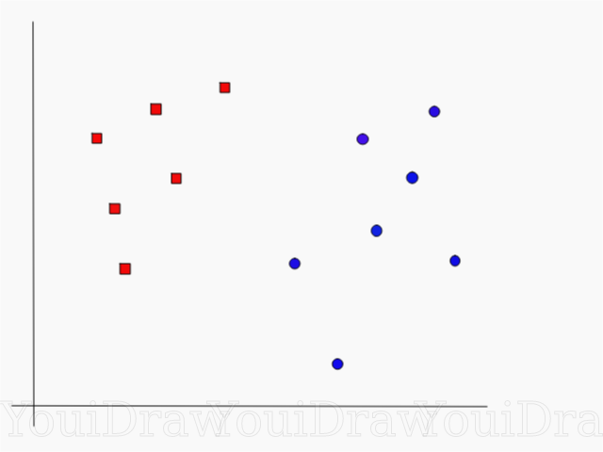
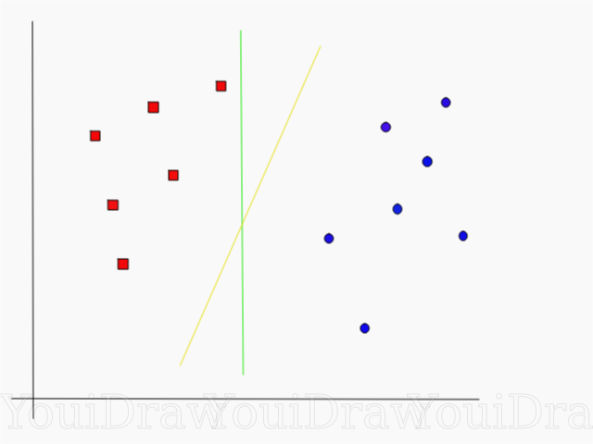
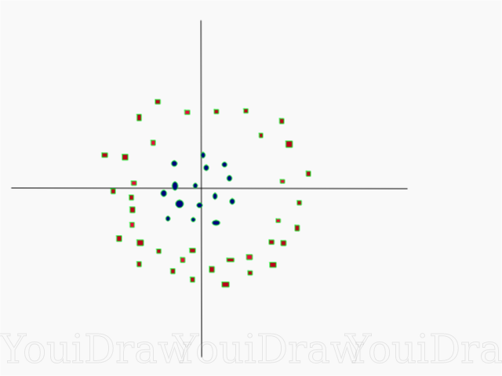
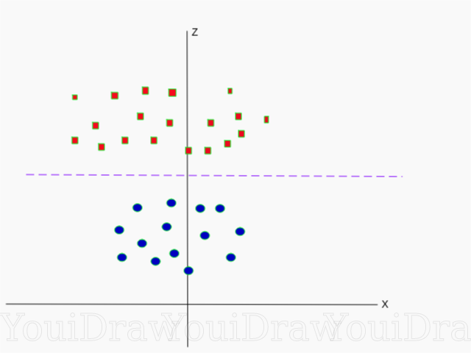
Support Vector Machine
SVM or Support Vector Machine is a linear model for classification and regression problems. It can solve linear and non-linear problems and work well for many practical problems. The idea of SVM is simple: The algorithm creates a line or a hyperplane which separates the data into classes. (Pupale, 2018)
According to the SVM algorithm we find the points closest to the line from both the classes. These points are called support vectors. Now, we compute the distance between the line and the support vectors. This distance is called the margin. Our goal is to maximize the margin. The hyperplane for which the margin is maximum is the optimal hyperplane.
Notes:
library e1071 svm

Slide 19
ARIMA (Autoregressive Integrated Moving Average Model)
An ARIMA model is a class of statistical models for analyzing and forecasting time series data.
It explicitly caters to a suite of standard structures in time series data, and as such provides a simple yet powerful method for making skillful time series forecasts.
AR: Autoregression. A model that uses the dependent relationship between an observation and some number of lagged observations.
I: Integrated. The use of differencing of raw observations (e.g. subtracting an observation from an observation at the previous time step) in order to make the time series stationary.
MA: Moving Average. A model that uses the dependency between an observation and a residual error from a moving average model applied to lagged observations.

Slide 20
Auto ARIMA
The parameters of the ARIMA model are defined as follows:
p: The number of lag observations included in the model, also called the lag order.
d: The number of times that the raw observations are differenced, also called the degree of differencing.
q: The size of the moving average window, also called the order of moving average.
Auto-arima generates a best fit values for (p,d,q).

Slide 21

Results and Discussion
Support Vector Machine, Time Series Forecasting and Prediction

Slide 22
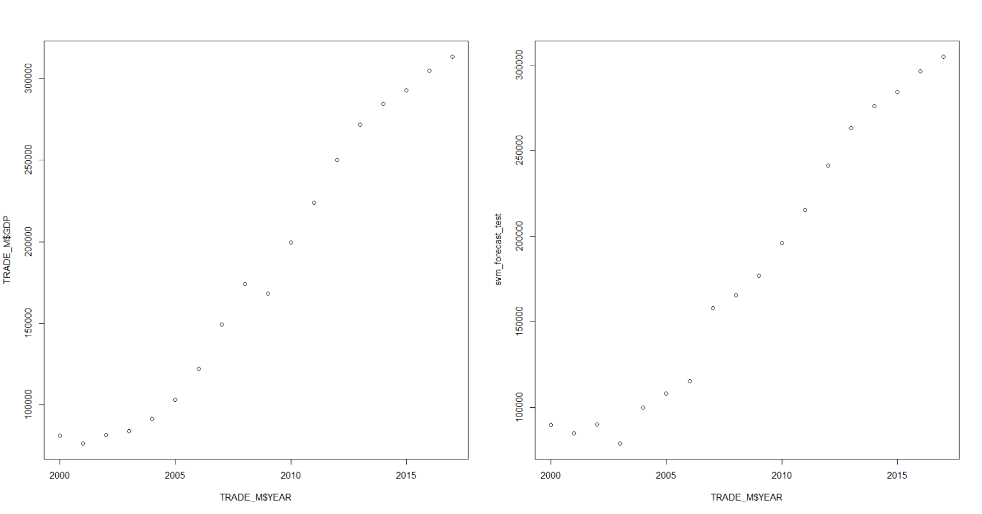
Support Vector Machine

Slide 23
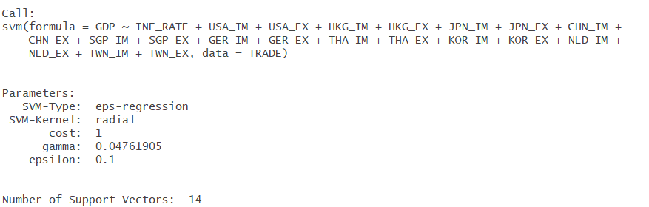
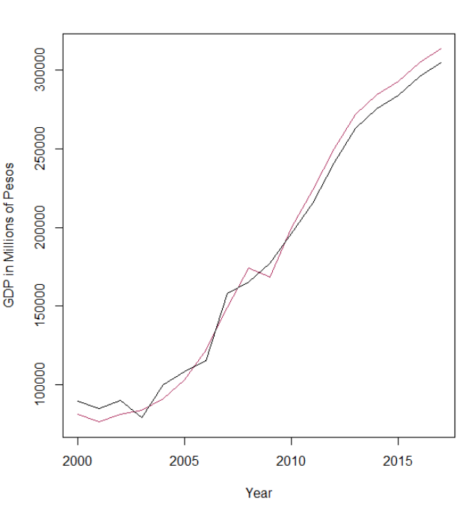
Support Vector Machine
EPS-Regression - are used for regression problems, where you want to predict a continuous number say housing price.
Kernel - used in training and predicting.
linear:u'*v
polynomial:(gamma*u'*v + coef0)^degree
radial basis: exp(-gamma*|u-v|^2)
sigmoid:tanh(gamma*u'*v + coef0)
Notes:
U is your initial line and v is your vector inner product
u_transpose * v is also called inner product

Slide 24
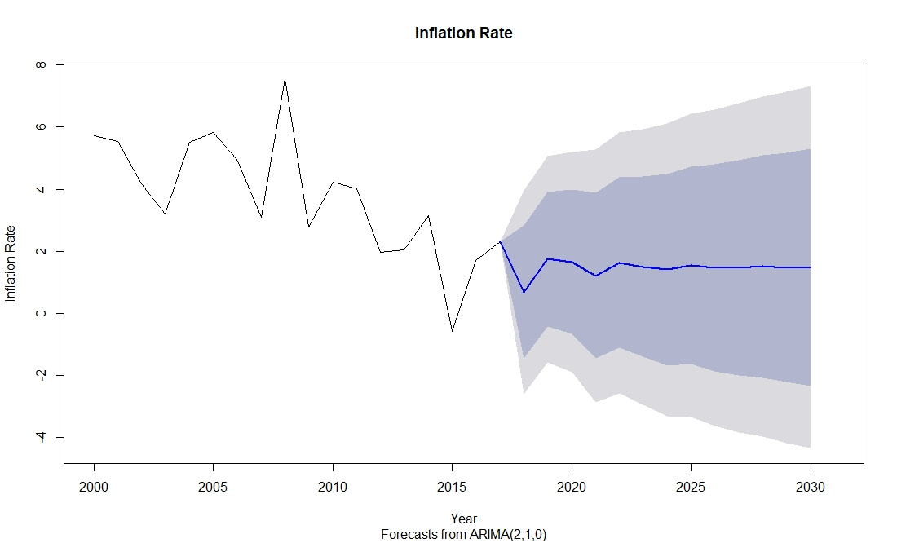
ARIMA
Inflation Rate

Slide 25
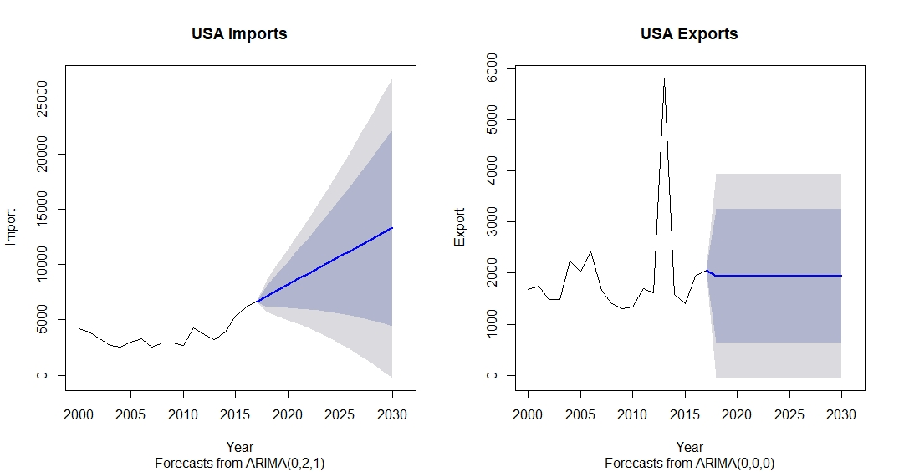
United States of America
Notes:
Exports refers to selling goods and services produced in the home country to other markets. Imports are derived from the conceptual meaning, as to bringing in the goods and services into the port of a country. An import in thereceiving country is an export to the sending country.

Slide 26
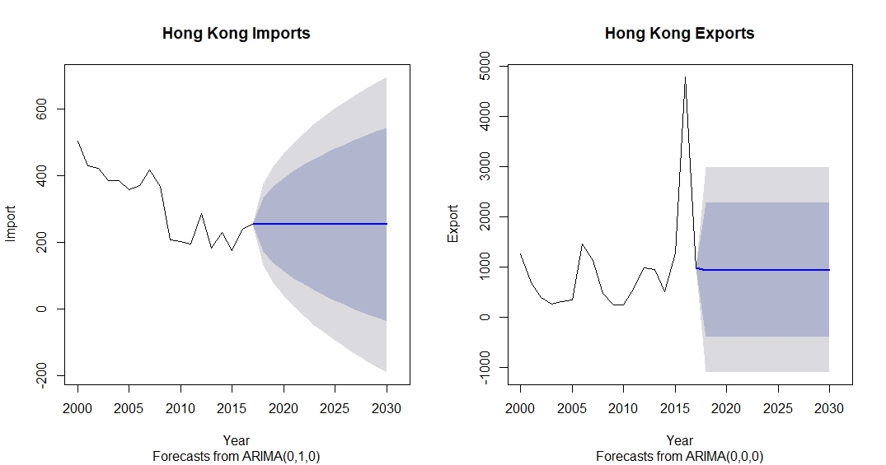

Hong Kong

Slide 27
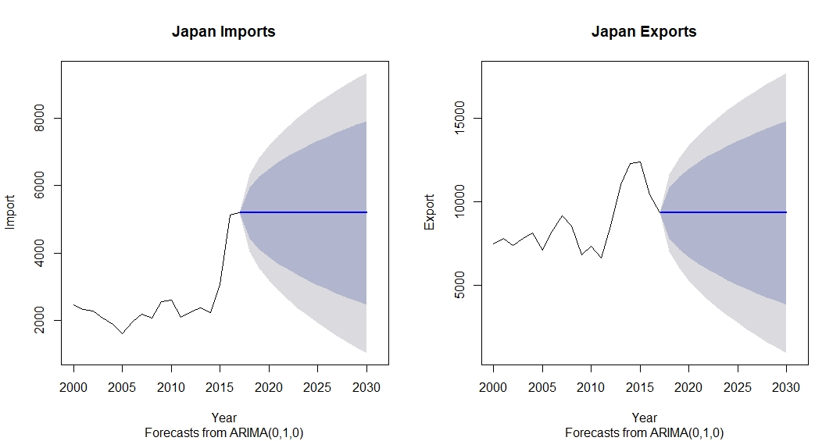

Japan

Slide 28
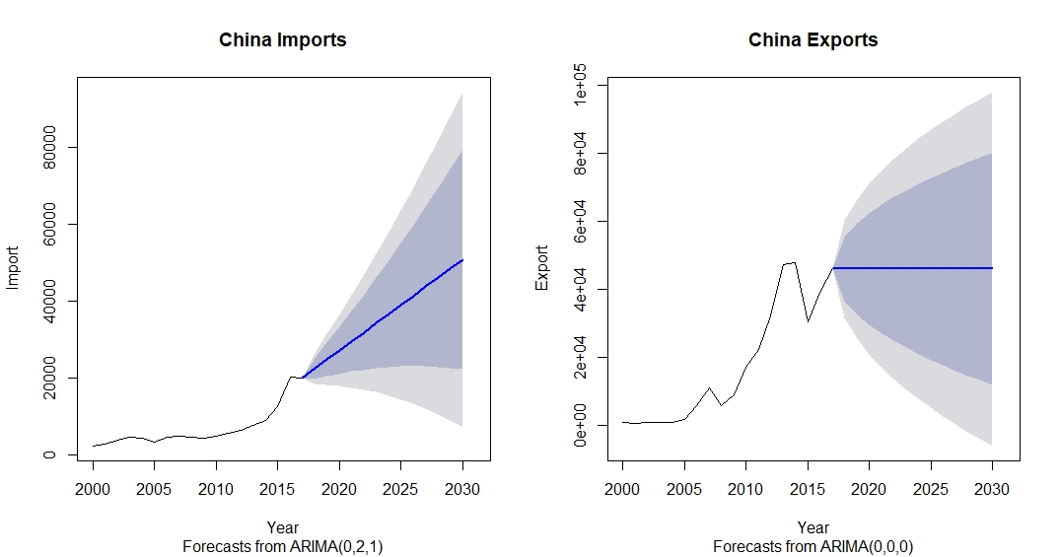

China

Slide 29
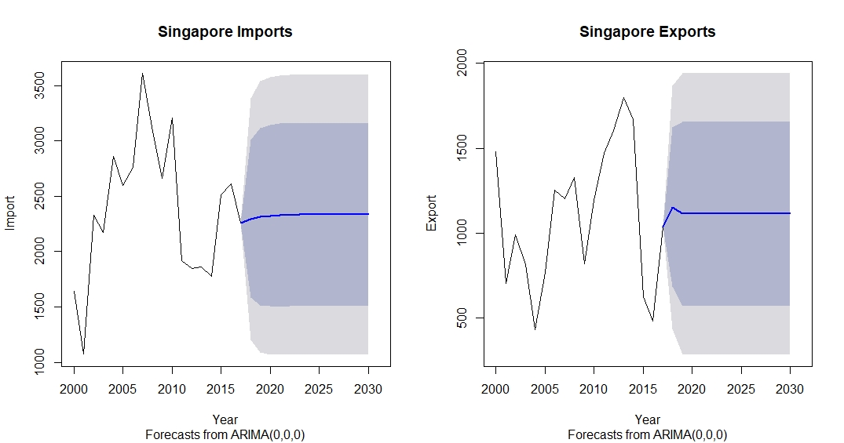

Singapore

Slide 30
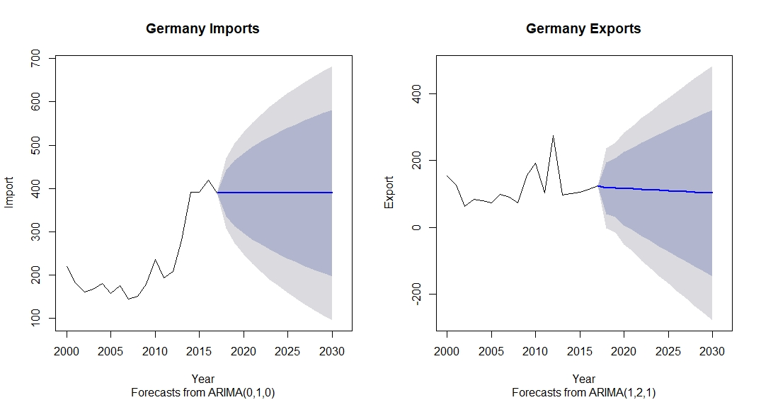

Germany

Slide 31
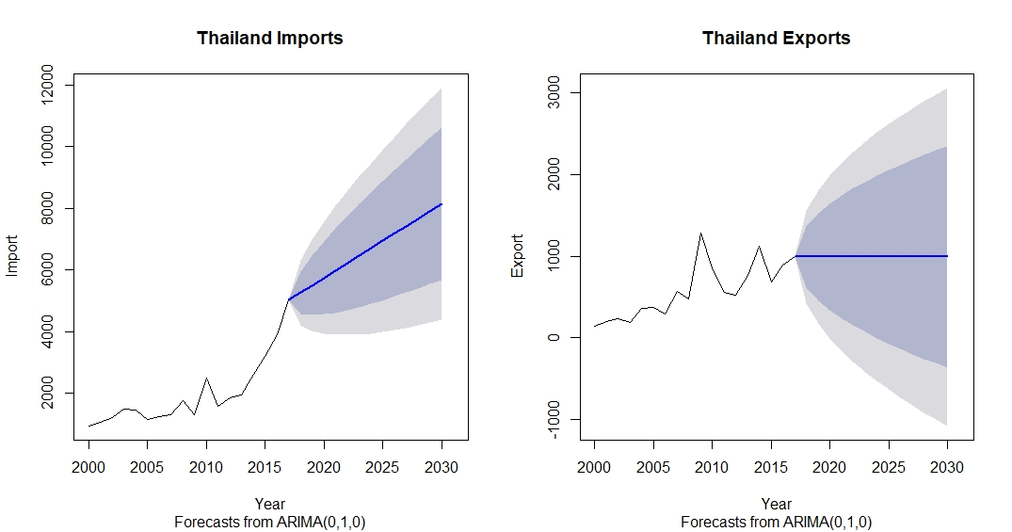

Thailand

Slide 32
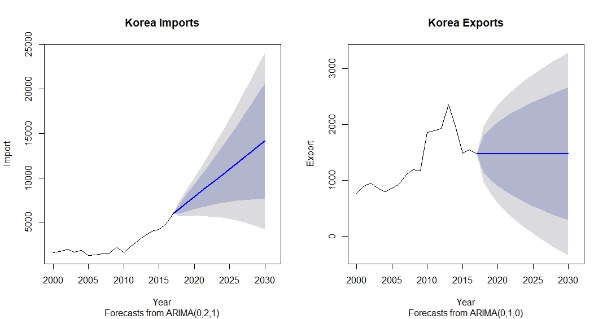

Korea

Slide 33
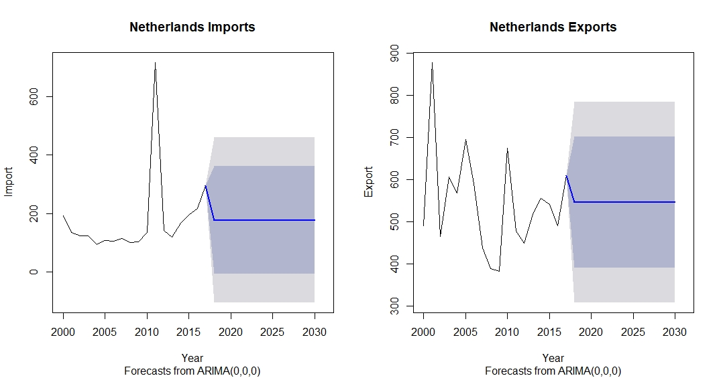

Netherlands

Slide 34
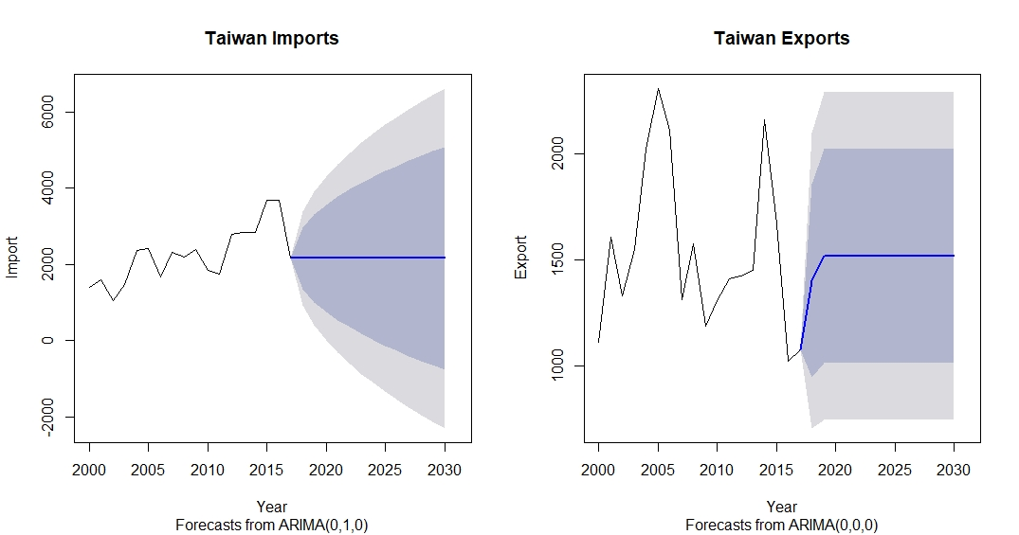

Taiwan

Slide 35
Notes:
Import -> 4 Increased, 6 Stabilized
Export -> 1 Decreased, 9 Stabilized

Slide 36
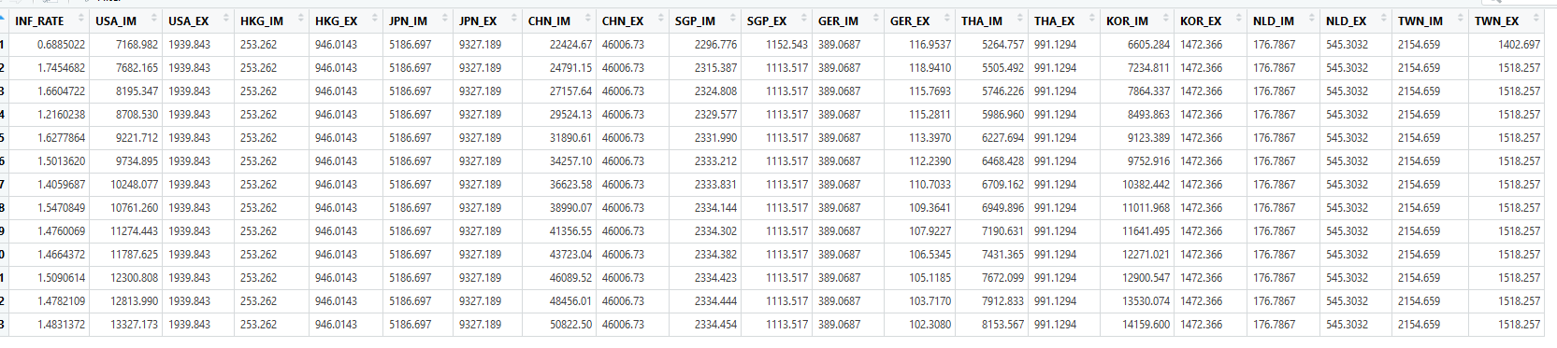
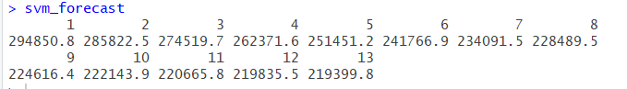
Prediction

Slide 37
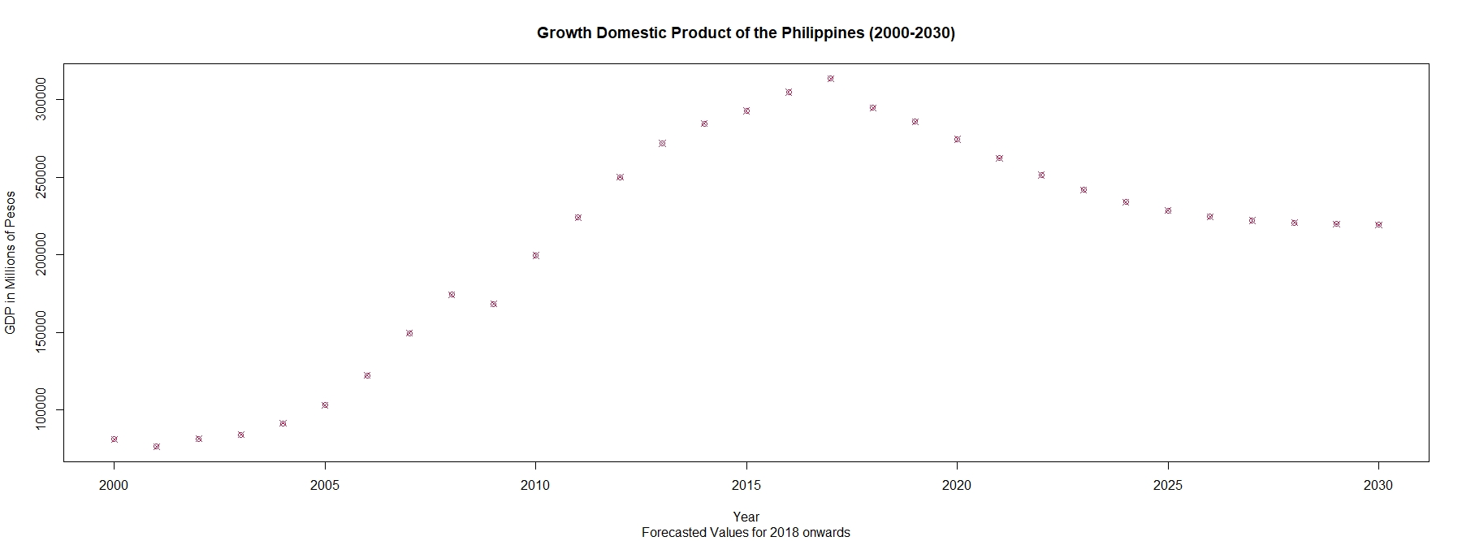
Prediction
We can observe a steady decline of the Gross Domestic Product of the Philippines starting from our forecast in 2018.

Slide 38

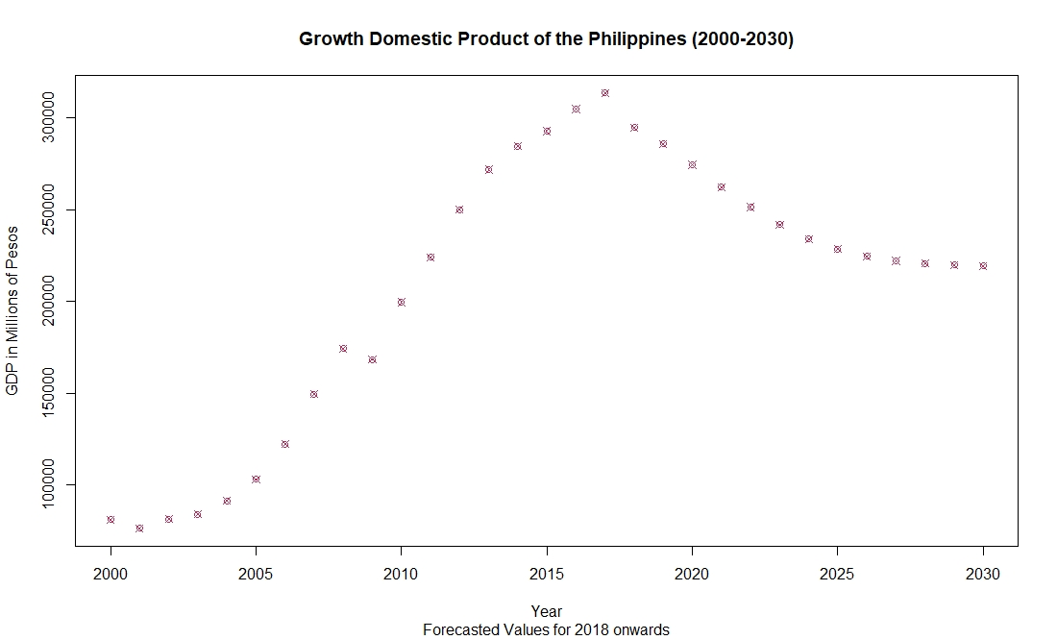
“Those exports bring money into the country, which increases the exporting nation's GDP. When a country imports goods, it buys them from foreign producers. The money spent on imports leaves the economy, and that decreases the importing nation's GDP.”
The Complete Idiot's Guide to Economics © 2003 by Tom Gorman

Slide 39

Conclusion
Through Support Vector Machine, I was able to create a reasonable model of forecasting the Growth Domestic Product of the Philippines from 2018 to 2030. The ARIMA models for the time series forecasting values for our import and export data GDP projection was also helpful in determining the pattern of the prediction in our SVM model.

Slide 40

Questions?

Slide 41
References
Ashworth, D. (2015). Economic Growth: Why Is It Important?. Retrieved 13 April 2019 from https://finance.yahoo.com/news/economic-growth-why-important-162936556.html
Brownlee, J. (2017). How to Create an ARIMA Model for Time Series Forecasting in Python. Retrieved 13 April from https://machinelearningmastery.com/arima-for-time-series-forecasting-with-python/
Gorman, T. (2003). The Complete Idiot's Guide to Economics
Kramer, L. (2019). Interesting Facts About Imports and Exports. Retrieved 13 April 2019 from https://www.investopedia.com/articles/investing/100813/interesting-facts-about-imports-and-exports.asp
Pupale, R. (2018). Support Vector Machines(SVM) — An Overview Retrieved 13 April 2019 from https://towardsdatascience.com/https-medium-com-pupalerushikesh-svm-f4b42800e989
Workman, D. (2019). Philippines Top Trading Partners. Retrieved 13 April 2019 from http://www.worldstopexports.com/philippines-top-import-partners/
Thank you

Slide 42
Notes:
library(car)
library(PerformanceAnalytics)
library(rpart) # Popular decision tree algorithm
library(rattle) # Fancy tree plot
library(rpart.plot) # Enhanced tree plots
library(RColorBrewer) # Color selection for fancy tree plot
library(party) # Alternative decision tree algorithm
library(partykit) # Convert rpart object to BinaryTree
library(caret) # Just a data source for this script
library(forecast)
library(ggplot2)
require(neuralnet)
library(e1071)
attach(TRADE_M)
summary(TRADE_M)
TRADE = TRADE_M
chart.Correlation(TRADE_M[2:23])
model_usa <- lm(GDP~USA_IM+USA_EX+INF_RATE) #0.5456
model_hkg <- lm(GDP~HKG_IM+HKG_EX+INF_RATE) #0.7433
model_jpn <- lm(GDP~JPN_IM+JPN_EX+INF_RATE) #0.6204
model_chn <- lm(GDP~CHN_IM+CHN_EX+INF_RATE) #0.901
model_sgp <- lm(GDP~SGP_IM+SGP_EX+INF_RATE) #0.4768
model_ger <- lm(GDP~GER_IM+GER_EX+INF_RATE) #0.6805
model_tha <- lm(GDP~THA_IM+THA_EX+INF_RATE) #0.7729
model_kor <- lm(GDP~KOR_IM+KOR_EX+INF_RATE) #0.8983
model_nld <- lm(GDP~NLD_IM+NLD_EX+INF_RATE) #0.4494
model_twn <- lm(GDP~TWN_IM+TWN_EX+INF_RATE) #0.5891
summary(model_usa)
summary(model_hkg)
summary(model_jpn)
summary(model_chn)
summary(model_sgp)
summary(model_ger)
summary(model_tha)
summary(model_kor)
summary(model_nld)
summary(model_twn)
linearmodel <-lm(GDP~INF_RATE
+USA_IM+USA_EX
+HKG_IM+HKG_EX
+JPN_IM+JPN_EX
+CHN_IM+CHN_EX
+SGP_IM+SGP_EX
+GER_IM+GER_EX
+THA_IM+THA_EX
+KOR_IM+KOR_EX
+NLD_IM+NLD_EX
+TWN_IM+TWN_EX)
summary(linearmodel)
treemodel <-rpart(GDP~INF_RATE
+USA_IM+USA_EX
+HKG_IM+HKG_EX
+JPN_IM+JPN_EX
+CHN_IM+CHN_EX
+SGP_IM+SGP_EX
+GER_IM+GER_EX
+THA_IM+THA_EX
+KOR_IM+KOR_EX
+NLD_IM+NLD_EX
+TWN_IM+TWN_EX ,
control =rpart.control(minsplit =2,minbucket=1, cp=0, maxdepth = 30),method = "anova")
summary(treemodel)
plot(treemodel)
text(treemodel)
nnmodel <-neuralnet(GDP~INF_RATE
+USA_IM+USA_EX
+HKG_IM+HKG_EX
+JPN_IM+JPN_EX
+CHN_IM+CHN_EX
+SGP_IM+SGP_EX
+GER_IM+GER_EX
+THA_IM+THA_EX
+KOR_IM+KOR_EX
+NLD_IM+NLD_EX
+TWN_IM+TWN_EX,
data=TRADE, hidden=1,act.fct = "logistic",
linear.output = FALSE,threshold=0.01, rep = 10)
plot(nnmodel)
svmmodel <-svm(GDP~INF_RATE
+USA_IM+USA_EX
+HKG_IM+HKG_EX
+JPN_IM+JPN_EX
+CHN_IM+CHN_EX
+SGP_IM+SGP_EX
+GER_IM+GER_EX
+THA_IM+THA_EX
+KOR_IM+KOR_EX
+NLD_IM+NLD_EX
+TWN_IM+TWN_EX,
data=TRADE)
newdata2 <- data.frame( INF_RATE = c(5.8,9.8),
USA_IM= c(12,4189495619),
USA_EX= c(1,4189495619),
HKG_IM= c(3,4189495619),
HKG_EX= c(5,4189495619),
JPN_IM= c(6,4189495619),
JPN_EX= c(6,4189495619),
CHN_IM= c(2,4189495619),
CHN_EX= c(3,4189495619),
SGP_IM= c(2,4189495619),
SGP_EX= c(5,4189495619),
GER_IM= c(8,4189495619),
GER_EX= c(9,2241001770),
THA_IM= c(10,4189495619),
THA_EX= c(10,4189495619),
KOR_IM= c(11,4189495619),
KOR_EX= c(11,4189495619),
NLD_IM= c(1,4189495619),
NLD_EX= c(11,4189495619),
TWN_IM= c(1,4189495619),
TWN_EX= c(11,4189495619)
)
x = predict(treemodel,newdata2)
x = predict(treemodel,newdata2)
x = predict(svmmodel,newdata2)
x
prp(treemodel)
prp(treemodel, varlen = 5)
treemodel_snip <- prp(treemodel,snip=TRUE)$obj
fancyRpartPlot(treemodel, sub = "Model for Import and Export")
inf_rate_ts = ts(INF_RATE, start = c(2000), frequency = 1)
inf_rate_arima <- auto.arima(inf_rate_ts)
inf_rate_arima_f <- forecast(inf_rate_arima, h=13)
plot(inf_rate_arima_f)
plot(inf_rate_arima_f, showgap = FALSE, xlab = 'Year', ylab = "Inflation Rate", main = "Inflation Rate", sub = "Forecasts from ARIMA(2,1,0)")
usa_im_ts = ts(USA_IM, start = c(2000), frequency = 1)
usa_im_arima <- auto.arima(usa_im_ts)
usa_im_arima_f <- forecast(usa_im_arima, h=13)
plot(usa_im_arima_f)
plot(usa_im_arima_f, showgap = FALSE, xlab = 'Year', ylab = "Import", main = "USA Imports", sub = "Forecasts from ARIMA(0,2,1)")
usa_ex_ts = ts(USA_EX, start = c(2000), frequency = 1)
usa_ex_arima <- auto.arima(usa_ex_ts)
usa_ex_arima_f <- forecast(usa_ex_arima, h=13)
plot(usa_ex_arima_f)
plot(usa_ex_arima_f, showgap = FALSE, xlab = 'Year', ylab = "Export", main = "USA Exports", sub = "Forecasts from ARIMA(0,0,0)")
hkg_im_ts = ts(HKG_IM, start = c(2000), frequency = 1)
hkg_im_arima <- auto.arima(hkg_im_ts)
hkg_im_arima_f <- forecast(hkg_im_arima, h=13)
plot(hkg_im_arima_f)
plot(hkg_im_arima_f, showgap = FALSE, xlab = 'Year', ylab = "Import", main = "Hong Kong Imports", sub = "Forecasts from ARIMA(0,1,0)")
hkg_ex_ts = ts(HKG_EX, start = c(2000), frequency = 1)
hkg_ex_arima <- auto.arima(hkg_ex_ts)
hkg_ex_arima_f <- forecast(hkg_ex_arima, h=13)
plot(hkg_ex_arima_f)
plot(hkg_ex_arima_f, showgap = FALSE, xlab = 'Year', ylab = "Export", main = "Hong Kong Exports", sub = "Forecasts from ARIMA(0,0,0)")
jpn_im_ts = ts(JPN_IM, start = c(2000), frequency = 1)
jpn_im_arima <- auto.arima(jpn_im_ts)
jpn_im_arima_f <- forecast(jpn_im_arima, h=13)
plot(jpn_im_arima_f)
plot(jpn_im_arima_f, showgap = FALSE, xlab = 'Year', ylab = "Import", main = "Japan Imports", sub = "Forecasts from ARIMA(0,1,0)")
jpn_ex_ts = ts(JPN_EX, start = c(2000), frequency = 1)
jpn_ex_arima <- auto.arima(jpn_ex_ts)
jpn_ex_arima_f <- forecast(jpn_ex_arima, h=13)
plot(jpn_ex_arima_f)
plot(jpn_ex_arima_f, showgap = FALSE, xlab = 'Year', ylab = "Export", main = "Japan Exports", sub = "Forecasts from ARIMA(0,1,0)")
chn_im_ts = ts(CHN_IM, start = c(2000), frequency = 1)
chn_im_arima <- auto.arima(chn_im_ts)
chn_im_arima_f <- forecast(chn_im_arima, h=13)
plot(chn_im_arima_f)
plot(chn_im_arima_f, showgap = FALSE, xlab = 'Year', ylab = "Import", main = "China Imports", sub = "Forecasts from ARIMA(0,2,1)")
chn_ex_ts = ts(CHN_EX, start = c(2000), frequency = 1)
chn_ex_arima <- auto.arima(chn_ex_ts)
chn_ex_arima_f <- forecast(chn_ex_arima, h=13)
plot(chn_ex_arima_f)
plot(chn_ex_arima_f, showgap = FALSE, xlab = 'Year', ylab = "Export", main = "China Exports", sub = "Forecasts from ARIMA(0,0,0)")
sgp_im_ts = ts(SGP_IM, start = c(2000), frequency = 1)
sgp_im_arima <- auto.arima(sgp_im_ts)
sgp_im_arima_f <- forecast(sgp_im_arima, h=13)
plot(sgp_im_arima_f)
plot(sgp_im_arima_f, showgap = FALSE, xlab = 'Year', ylab = "Import", main = "Singapore Imports", sub = "Forecasts from ARIMA(0,0,0)")
sgp_ex_ts = ts(SGP_EX, start = c(2000), frequency = 1)
sgp_ex_arima <- auto.arima(sgp_ex_ts)
sgp_ex_arima_f <- forecast(sgp_ex_arima, h=13)
plot(sgp_ex_arima_f)
plot(sgp_ex_arima_f, showgap = FALSE, xlab = 'Year', ylab = "Export", main = "Singapore Exports", sub = "Forecasts from ARIMA(0,0,0)")
ger_im_ts = ts(GER_IM, start = c(2000), frequency = 1)
ger_im_arima <- auto.arima(ger_im_ts)
ger_im_arima_f <- forecast(ger_im_arima, h=13)
plot(ger_im_arima_f)
plot(ger_im_arima_f, showgap = FALSE, xlab = 'Year', ylab = "Import", main = "Germany Imports", sub = "Forecasts from ARIMA(0,1,0)")
ger_ex_ts = ts(GER_EX, start = c(2000), frequency = 1)
ger_ex_arima <- auto.arima(ger_ex_ts)
ger_ex_arima <- arima(ger_ex_ts, order = c(1,2,1))
ger_ex_arima_f <- forecast(ger_ex_arima, h=13)
plot(ger_ex_arima_f)
plot(ger_ex_arima_f, showgap = FALSE, xlab = 'Year', ylab = "Export", main = "Germany Exports", sub = "Forecasts from ARIMA(1,2,1)")
tha_im_ts = ts(THA_IM, start = c(2000), frequency = 1)
tha_im_arima <- auto.arima(tha_im_ts)
tha_im_arima_f <- forecast(tha_im_arima, h=13)
plot(tha_im_arima_f)
plot(tha_im_arima_f, showgap = FALSE, xlab = 'Year', ylab = "Import", main = "Thailand Imports", sub = "Forecasts from ARIMA(0,1,0)")
tha_ex_ts = ts(THA_EX, start = c(2000), frequency = 1)
tha_ex_arima <- auto.arima(tha_ex_ts)
tha_ex_arima_f <- forecast(tha_ex_arima, h=13)
plot(tha_ex_arima_f)
plot(tha_ex_arima_f, showgap = FALSE, xlab = 'Year', ylab = "Export", main = "Thailand Exports", sub = "Forecasts from ARIMA(0,1,0)")
kor_im_ts = ts(KOR_IM, start = c(2000), frequency = 1)
kor_im_arima <- auto.arima(kor_im_ts)
kor_im_arima_f <- forecast(kor_im_arima, h=13)
plot(kor_im_arima_f)
plot(kor_im_arima_f, showgap = FALSE, xlab = 'Year', ylab = "Import", main = "Korea Imports", sub = "Forecasts from ARIMA(0,2,1)")
kor_ex_ts = ts(KOR_EX, start = c(2000), frequency = 1)
kor_ex_arima <- auto.arima(kor_ex_ts)
kor_ex_arima_f <- forecast(kor_ex_arima, h=13)
plot(kor_ex_arima_f)
plot(kor_ex_arima_f, showgap = FALSE, xlab = 'Year', ylab = "Export", main = "Korea Exports", sub = "Forecasts from ARIMA(0,1,0)")
nld_im_ts = ts(NLD_IM, start = c(2000), frequency = 1)
nld_im_arima <- auto.arima(nld_im_ts)
nld_im_arima_f <- forecast(nld_im_arima, h=13)
plot(nld_im_arima_f)
plot(nld_im_arima_f, showgap = FALSE, xlab = 'Year', ylab = "Import", main = "Netherlands Imports", sub = "Forecasts from ARIMA(0,0,0)")
nld_ex_ts = ts(NLD_EX, start = c(2000), frequency = 1)
nld_ex_arima <- auto.arima(nld_ex_ts)
nld_ex_arima_f <- forecast(nld_ex_arima, h=13)
plot(nld_ex_arima_f)
plot(nld_ex_arima_f, showgap = FALSE, xlab = 'Year', ylab = "Export", main = "Netherlands Exports", sub = "Forecasts from ARIMA(0,0,0)")
twn_im_ts = ts(TWN_IM, start = c(2000), frequency = 1)
twn_im_arima <- auto.arima(twn_im_ts)
twn_im_arima_f <- forecast(twn_im_arima, h=13)
plot(twn_im_arima_f)
plot(twn_im_arima_f, showgap = FALSE, xlab = 'Year', ylab = "Import", main = "Taiwan Imports", sub = "Forecasts from ARIMA(0,1,0)")
twn_ex_ts = ts(TWN_EX, start = c(2000), frequency = 1)
twn_ex_arima <- auto.arima(twn_ex_ts)
twn_ex_arima_f <- forecast(twn_ex_arima, h=13)
plot(twn_ex_arima_f)
plot(twn_ex_arima_f, showgap = FALSE, xlab = 'Year', ylab = "Export", main = "Taiwan Exports", sub = "Forecasts from ARIMA(0,0,0)")
# usa_im_arima <- arima(USA_IM, order = c(0,0,0))
forecast_predictors <- data.frame( INF_RATE = inf_rate_arima_f$mean,
USA_IM= usa_im_arima_f$mean,
USA_EX= usa_ex_arima_f$mean,
HKG_IM= hkg_im_arima_f$mean,
HKG_EX= hkg_ex_arima_f$mean,
JPN_IM= jpn_im_arima_f$mean,
JPN_EX= jpn_ex_arima_f$mean,
CHN_IM= chn_im_arima_f$mean,
CHN_EX= chn_ex_arima_f$mean,
SGP_IM= sgp_im_arima_f$mean,
SGP_EX= sgp_ex_arima_f$mean,
GER_IM= ger_im_arima_f$mean,
GER_EX= ger_ex_arima_f$mean,
THA_IM= tha_im_arima_f$mean,
THA_EX= tha_ex_arima_f$mean,
KOR_IM= kor_im_arima_f$mean,
KOR_EX= kor_ex_arima_f$mean,
NLD_IM= nld_im_arima_f$mean,
NLD_EX= nld_ex_arima_f$mean,
TWN_IM= twn_im_arima_f$mean,
TWN_EX= twn_ex_arima_f$mean
)
tree_forecast = predict(svmmodel,forecast_predictors)
# tree_forecast = predict(svmmodel,TRADE_M)
plot(GDP)
tree_forecast
plot(tree_forecast)
trade_all = TRADE
trade_all$USA_EX(19-25) <- rbind(usa_ex_arima_f$mean)
forecast <- data.frame(
YEAR = c(2018,2019,2020,2021,2022,2023,2024,2025,2026,2027,2028,2029,2030),
GDP = tree_forecast,
INF_RATE = inf_rate_arima_f$mean,
USA_IM= usa_im_arima_f$mean,
USA_EX= usa_ex_arima_f$mean,
HKG_IM= hkg_im_arima_f$mean,
HKG_EX= hkg_ex_arima_f$mean,
JPN_IM= jpn_im_arima_f$mean,
JPN_EX= jpn_ex_arima_f$mean,
CHN_IM= chn_im_arima_f$mean,
CHN_EX= chn_ex_arima_f$mean,
SGP_IM= sgp_im_arima_f$mean,
SGP_EX= sgp_ex_arima_f$mean,
GER_IM= ger_im_arima_f$mean,
GER_EX= ger_ex_arima_f$mean,
THA_IM= tha_im_arima_f$mean,
THA_EX= tha_ex_arima_f$mean,
KOR_IM= kor_im_arima_f$mean,
KOR_EX= kor_ex_arima_f$mean,
NLD_IM= nld_im_arima_f$mean,
NLD_EX= nld_ex_arima_f$mean,
TWN_IM= twn_im_arima_f$mean,
TWN_EX= twn_ex_arima_f$mean
)
g = rbind(TRADE, forecast)
plot(g$YEAR, g$GDP)

